Slide 1

A Fusion Approach to Infrared and Visible Images
Date: 19 April 2021
Ms. RAHELA MAHENAZ : 17WH1A0595
Ms. P. DIVYA REKHA : 18WH5A0515
Ms. A. SRAVYA : 17WH1A0590
Internal Guide: Ms.G.NAGAMANI
Designation: Assistant Professor
Department of Computer Science & Engineering
BVRIT HYDERABAD College of Engineering for Women

Slide 2
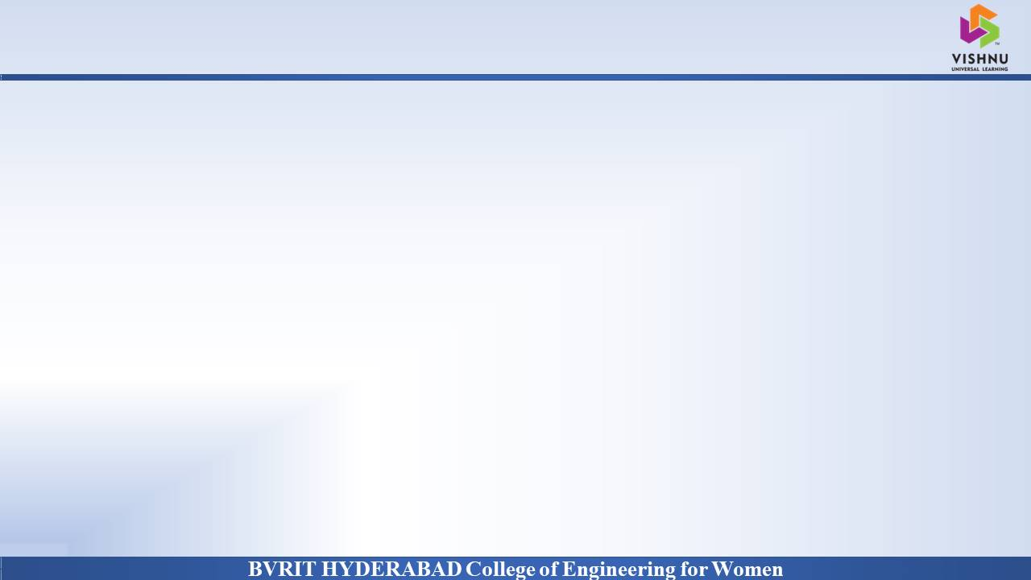
Why Should I Study this course?
ABSTRACT
Examples
The infrared and visible image fusion task is an important problem in image processing field. It attempts to extract salient features from source images, then these features are integrated into a single image by appropriate fusion method. We are using a novel deep learning architecture for infrared and visible images fusion. In contrast to conventional convolutional networks, our encoding network is combined with convolutional layers, a fusion layer, and dense block in which the output of each layer is connected to every other layer.
BVRIT HYDERABAD College of Engineering for Women

Slide 3
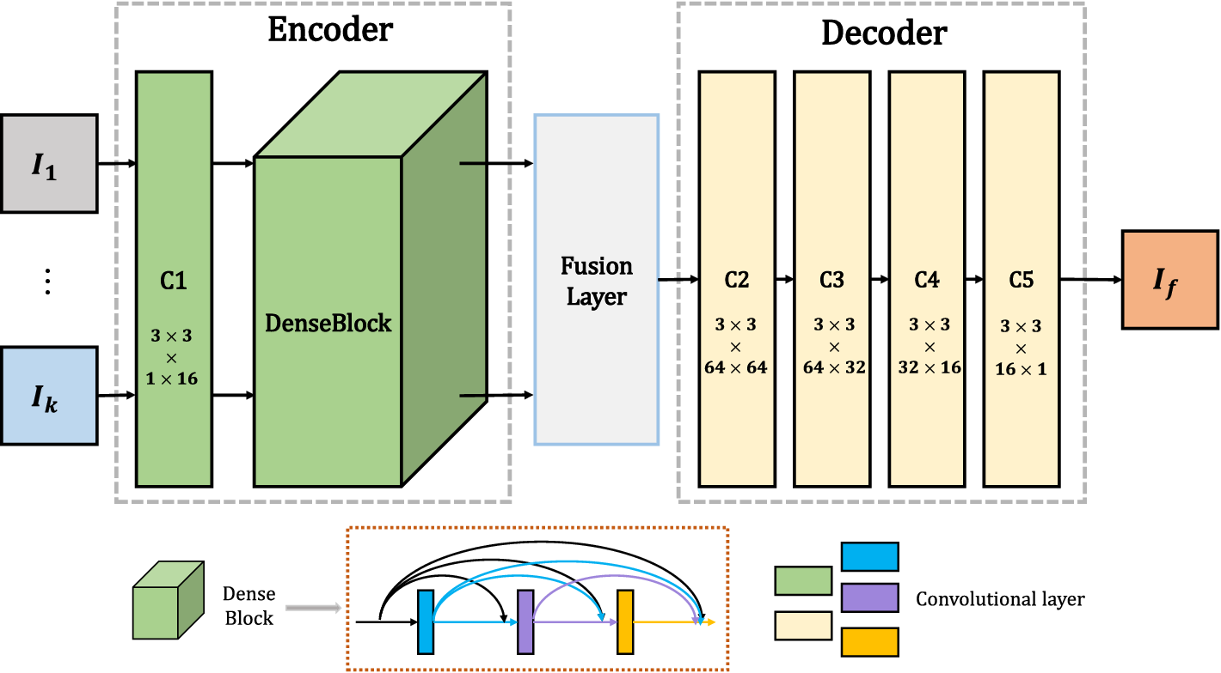
Why Should I Study this course?
Design architecture
Examples
BVRIT HYDERABAD College of Engineering for Women

Slide 4
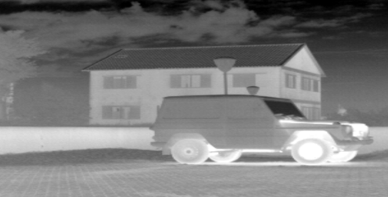



Data Model
IR IMAGES
VISIBILE IMAGES
UPLOAD
FUSION STRATGEY
FUSED IMAGE

Slide 5
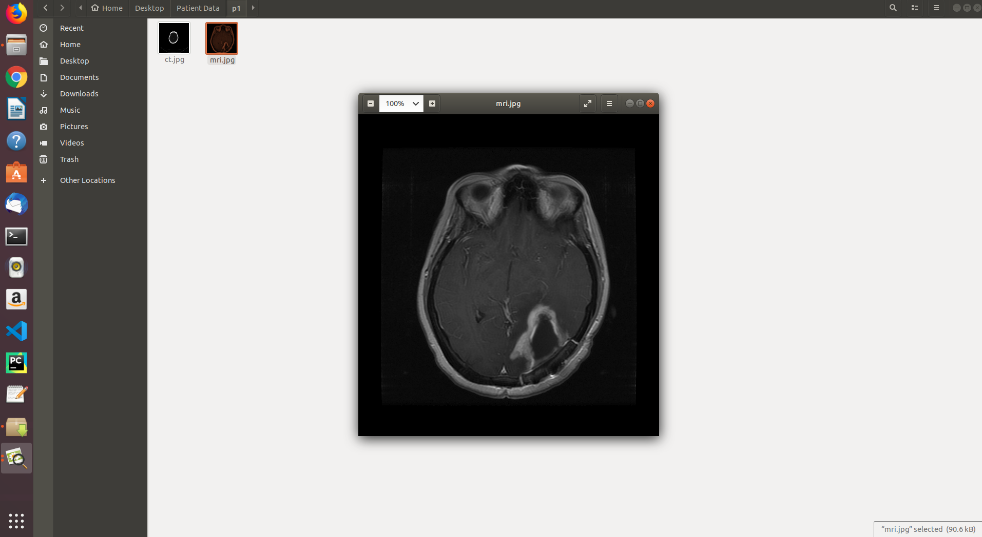
Why Should I Study this course?
Data Set
This is a Powerline Image Dataset (Infrared-IR and Visible Light-VL)
The images were captured from 21 different regions all over Turkey at different seasonal days. Due to varying background behaviour, varying temperatures and weather conditions, and varying lighting conditions, the achieved positive set contains several difficult scenes where low contrast causes close-to invisibility for power lines. The original video resolutions were 576x325 for IR and full HD for VL, however, the captured frames were scaled down to smaller sizes and the effect of resizing was tested for various image sizes. An image size of 128x128 is sufficient for a consistently accurate power line recognition.
https://data.mendeley.com/datasets/n6wrv4ry6v/8
Examples
BVRIT HYDERABAD College of Engineering for Women

Slide 6
Why Should I Study this course?
SYSTEM SPECIFICATIONS
Examples
ENVIRONMENT | SPECIFICATIONS
HARDWARE | Processor - Intel Core i3/i5 Memory(RAM) - 8 GB Storage – I TB
SOFTWARE | Python OS - Windows 10 Pycharm
BVRIT HYDERABAD College of Engineering for Women

Slide 7
Why Should I Study this course?
REFERENCES
[1] Hui Li and Xiao-Jun Wu, DenseFuse: A Fusion Approach to Infrared and Visible Images, IEEE Transactions on image processing, Vol 28, No : 5, May 2019 [Base Paper]
[2] S. Li, X. Kang, L. Fang, J. Hu, and H. Yin, “Pixel-level image fusion: A survey of the state of the art”, Inf Fusion, vol. 33, pp. 100–112, Jan 2017.
[3] L. Wang, B. Li, and L.-F. Tian, “EGGDD: An explicit dependency model for multi-modal medical image fusion in shift-invariant shearlet transform domain,” Inf. Fusion, vol. 19, pp. 29–37, Sep 2014.
[4] D. P. Bavirisetti and R. Dhuli, “Two-scale image fusion of visible and infrared images using saliency detection,” Infr. Phys. Technol., vol. 76, pp. 52–64, May 2016
[5] Y. Liu, X. Chen, H. Peng, and Z. Wang, “Multi-focus image fusion with a deep convolutional neural network,” Inf. Fusion, vol. 36 pp. 191–207, Jul 2017.
Examples
BVRIT HYDERABAD College of Engineering for Women

Slide 8
Thank You
BVRIT HYDERABAD College of Engineering for Women

